Slide 1



Web Development Back-End
Server Features:
Real-Time Communication

Slide 2


Outline
Server Features
Real-Time Communication
Polling
Server-Sent Events
Web Sockets
Socket.io
WebRTC

Slide 3
Real-Time Communication
It can be tedious to constantly initiate communication between client-server or client-client
Repetitive connection handshakes
Sometimes we need data often (and maybe quickly)
Polling
Server-Sent Events (SSE)
WebSockets
WebRTC

Slide 4
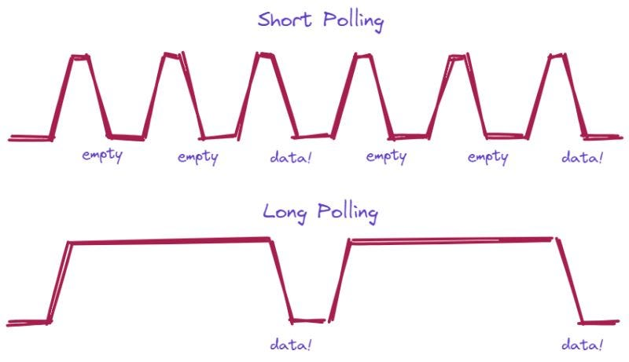
Polling
If the latency of new data is not important:
Ask for new data periodically
ex. setInterval with a fetch request
Long and Short Polling
Short is simpler but more expensive
Long is more effective but requires connection management

Slide 5
Server-Side Events
Establish a client-to-server (unidirectional) persistent connection to send only text data via regular HTTP
Set these headers and use the EventSource client-side API
res.setHeader('Content-Type', 'text/event-stream');
res.setHeader('Cache-Control', 'no-cache');
res.setHeader('Connection', 'keep-alive');
// Send an initial message to the client
res.write('data: Connected to the server\n\n');
// Send a new message every second
const intervalId = setInterval(() => {
const message = `Current time: ${new Date().toLocaleTimeString()}`;
res.write(`data: ${message}\n\n`); // Send data in the SSE format
}, 1000);

Slide 6
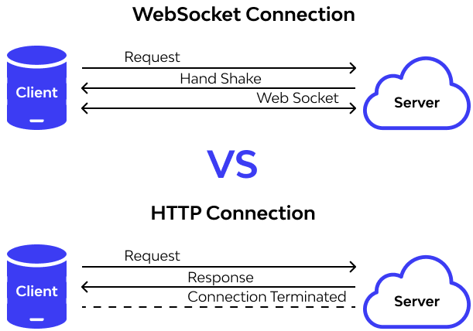
Web Sockets
Establish a client-sever (bidirectional) connection that stays open for multiple data transfers
Client – WebSocket API
Node Server – ws library

Slide 7

A popular WebSocket library for simplified management of many client connections and communication events
https://socket.io/

Slide 8

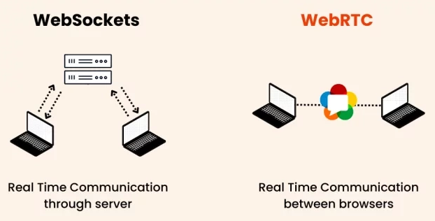
Commonly used for peer-to-peer audio and video calls
https://webrtc.org/

Slide 9
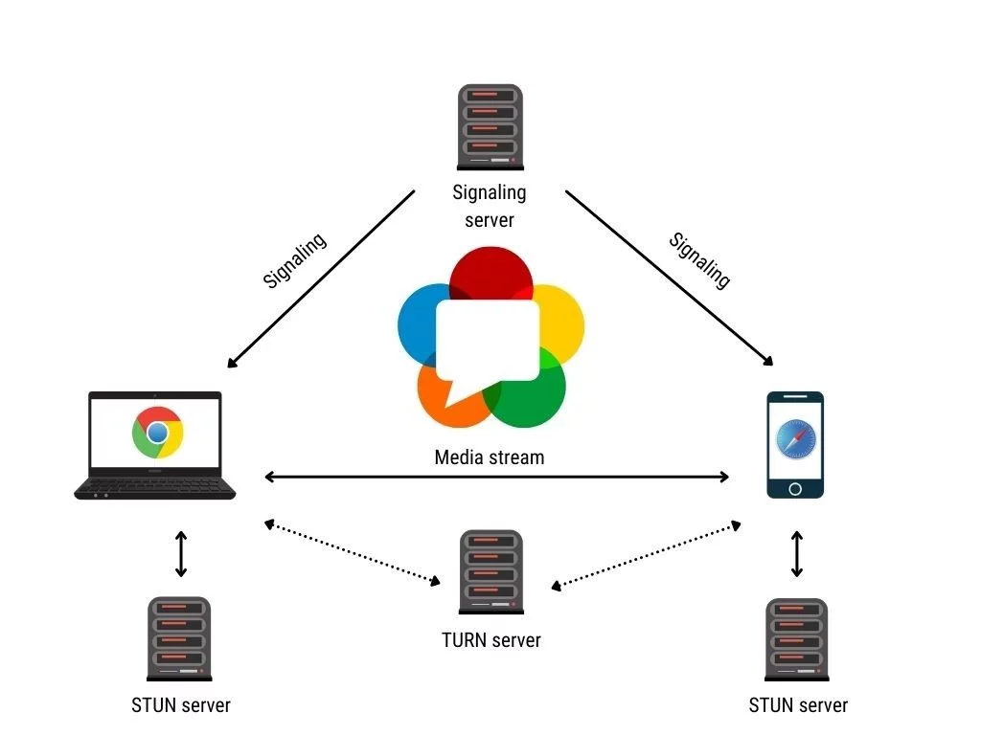

Slide 10
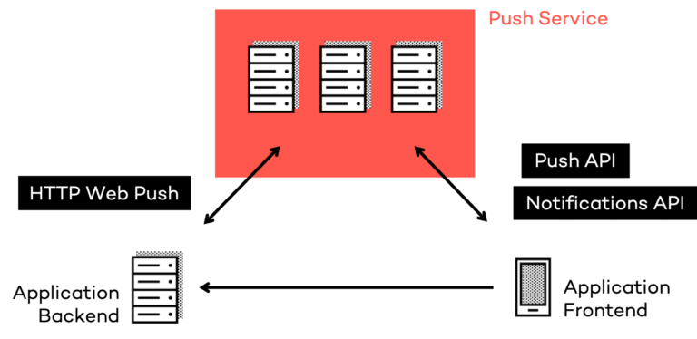
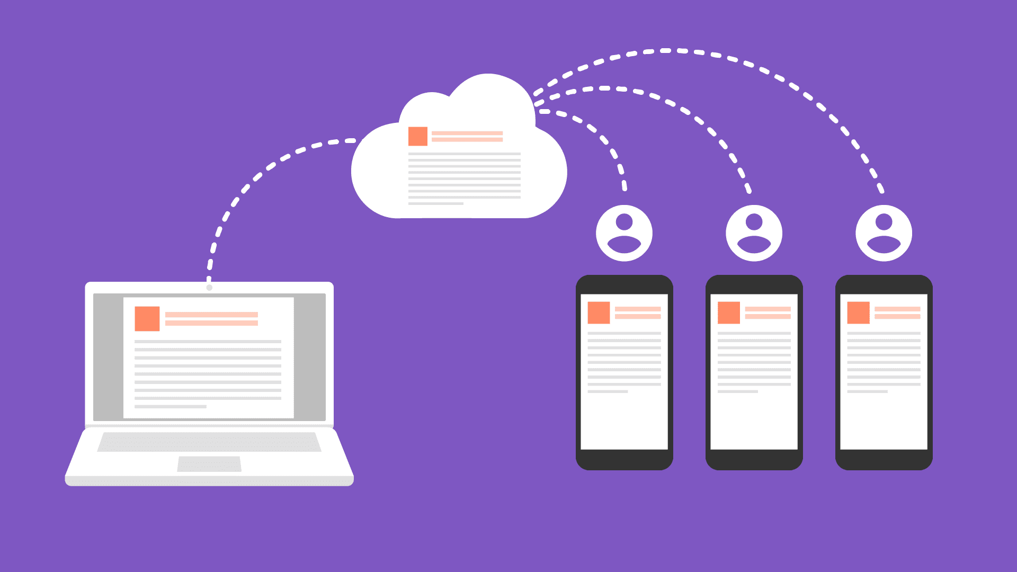
Other Strategies
Server Push with HTTP 2 and 3
Push Notifications API
Firebase and Supabase database change subscriptions
https://en.wikipedia.org/wiki/HTTP/2_Server_Push
https://www.smashingmagazine.com/2017/04/guide-http2-server-push/

